Slide 1
WAR
A Java console application which runs a variant of the classic card game, known by the same name.

Slide 2
Directions
In the main menu, choose to either start a game or exit the application.
If choosing to start a game, each player must enter their name.
One both players have entered their names, the deck is shuffled, dealt to each player, and a game of WAR ensues. This entire process is automated since there are no choices in the card game WAR and all outcomes are random.

Slide 3
An example of a game
The following slides show an example of a single game being played.

Slide 4
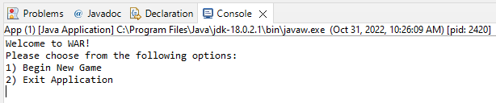
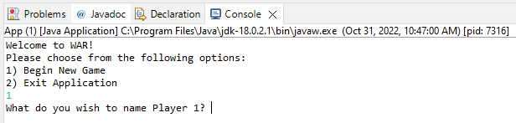
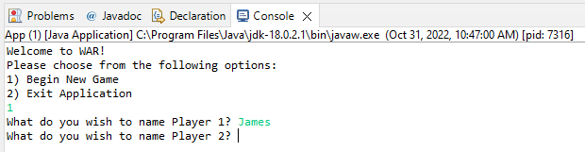
Starting a Game
You can start a game or exit the application.
Upon choosing to start a game, the players must enter a name for Player 1.
Once a name for is entered for Player 1,the players then enter a name for Player 2.
The first few steps of starting a game of WAR.

Slide 5
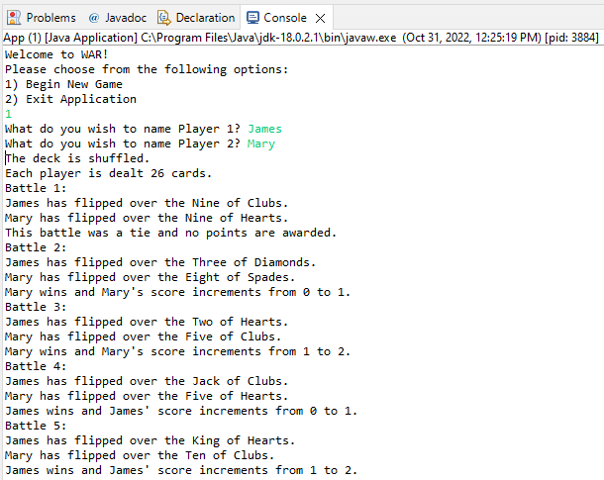
A WAR Begins
Once players’ names have been chosen, a deck is shuffled, and the cards are dealt to the two players.
There are 26 “battles” for a single game of war.
Each “battle” consists of the two players each flipped the top card of their deck and comparing the cards ranks. If one player flips a card with a higher rank, they receive a point from winning the “battle.”
Here we see the first five battles of a game of WAR between players James and Mary.

Slide 6
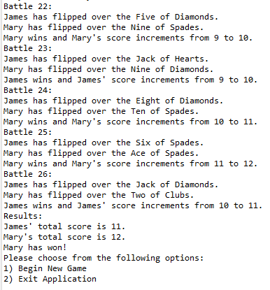
A Victor Emerges
After the completion of 26 “battles,” the player with the higher score (i.e., the player that received the most points) wins the game of WAR. If the scores are tied, then the game results in a tie.
Once the winner is revealed, the players are returned to the main menu where a new game can be started, or the app can be exited.
Mary wins the game.

Slide 7
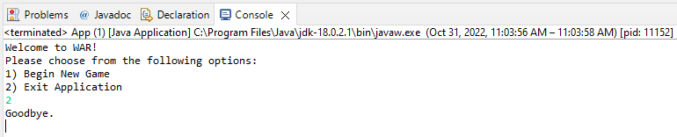
Exiting the Application
Upon choosing Exit Application on the main menu the application terminates.
The application states “Goodbye.” Then terminates.

Slide 8
That’s it
That concludes an example of a single game of WAR being played between two opponents.

Slide 9
Possible upcoming features:
A user interface including clickable or draggable images of the cards.
Players receiving the cards from the “battle,” instead of points.
“Battle” ties resulting in a “war” where three cards are flipped face down and then another “battle” occurs until there is no longer a tie. In this case the winner would get all the cards from the “war.”
Upon reaching the end of a player’s deck, said deck being repopulated with the cards they won, after shuffling them.
The game continuing until a player is out of cards at which point, they would lose the game.

